Slide 1
Educational Android Application Android Application to Teach and Spread Awareness Among Adolescent Girls
Team Members:-
Aditi Jain (18ETCCS003)
Tejasvini Mehta (18ETCCS090)
Vrati Bhandari (18ETCCS096)
Notes:
Delete this slide when you finish preparing the other slides.

Slide 2
About Project
The purpose of this android application is to spread awareness about menstruation hygiene among remote area adolescent girls.
The users of this application are girls from villages who are not aware of the ways to stay healthy and hygienic during menstruation.
It contains Modules in the form of PDF files and YouTube links.

Slide 3

Resources and Languages Used
Android Studio
FIREBASE
Android Software Development Kit
AVD Manager (Android Virtual Device)
Backend - JAVA
Frontend – XML
JDK (Java Development Kit)
Developers

Slide 4
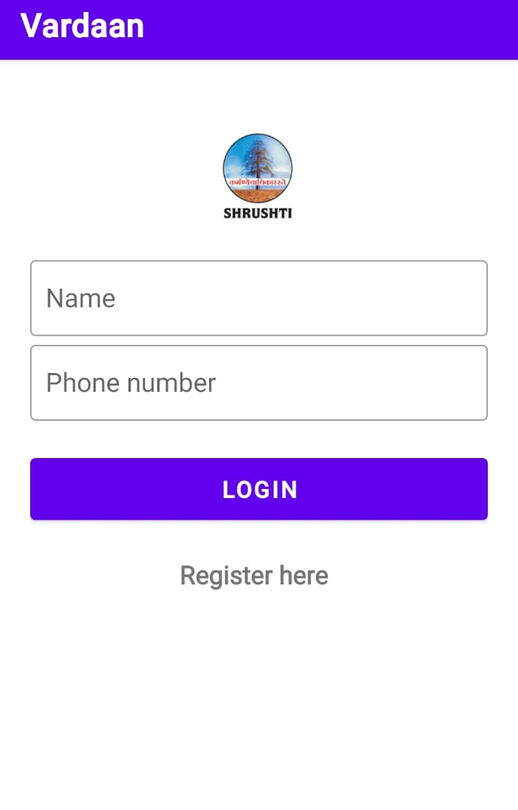
What does the application look like? Main Activity A user can Log in to the application using this activity.

Slide 5
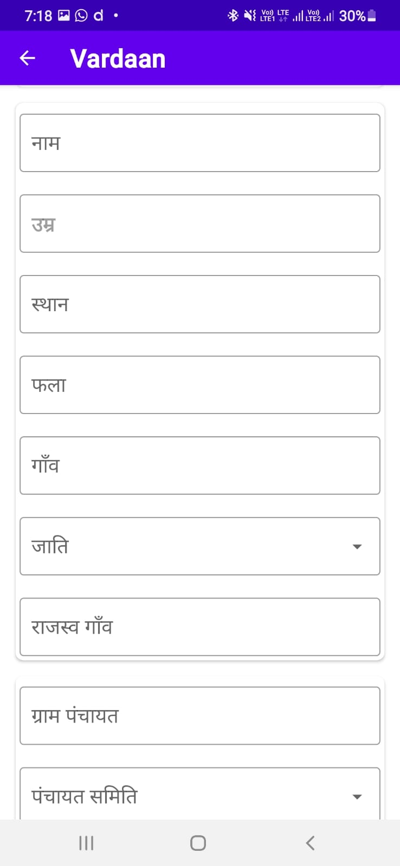
Register Activity A user can make a new account using this activity. By providing the information required.

Slide 6
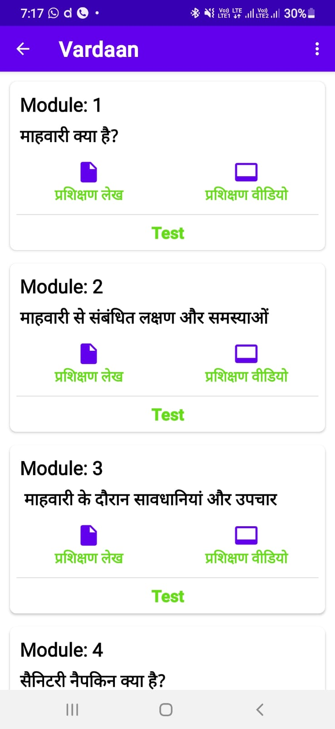
Dashboard *It contains 6 modules in pdf form, direct youtube links, and tests. *Shows the learning curve of the user.

Slide 7
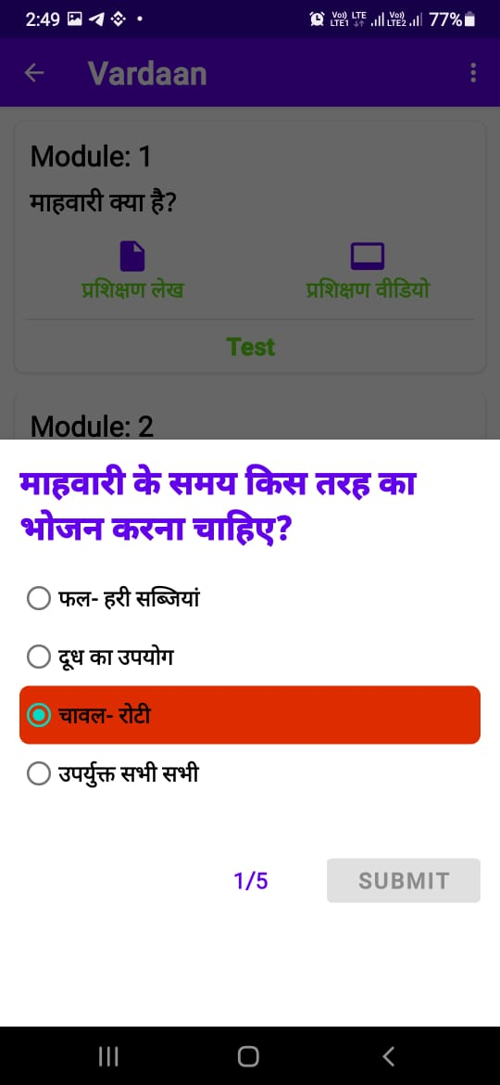
Test It contains Questions and 4 Multiple choice options.

Slide 8
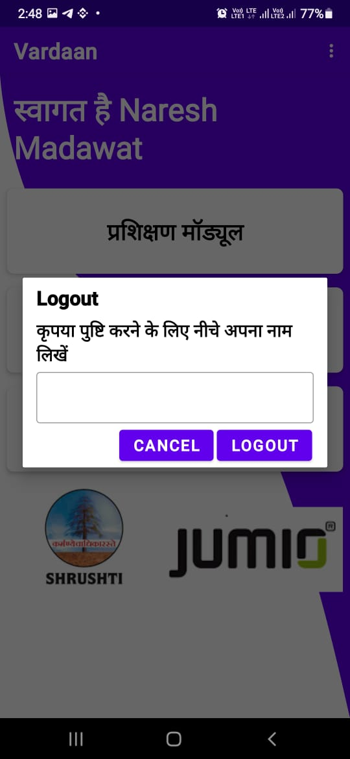
LogOut

Slide 9
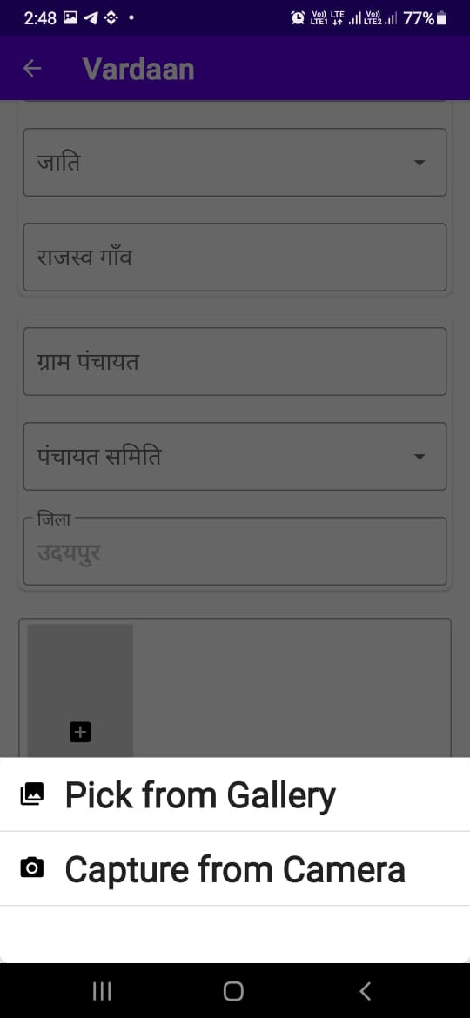
Registration

Slide 10

Advantages of android application
User Friendly –
The language used is Hindi.
UI/UX –
Simple Visuals, Outstanding Combinations, and user-friendly interfaces.
Database –
Firebase is easy to use and check the data.
Adaptable –
Adaptable to new changes in functions according to requirements.

Slide 11

Conclusion
It is an android application for learning purposes for users from different areas. Through the development of this Android application in Android Studio, we got a clear understanding of the overall process of the system.
We learned –
Android Studio
FIREBASE
Team Work
Time Management

